Slide 1

Team Fierce – STM009 Smart Transportation & Mobility
Team Members:
Chandine .S
Richie soshan E
Ashwanth Nitin
Darsana Barathi

Slide 2
Index
Motivation
Problem Statement
Introduction
Novelty
Architecture
Demo
Features
References

Slide 3
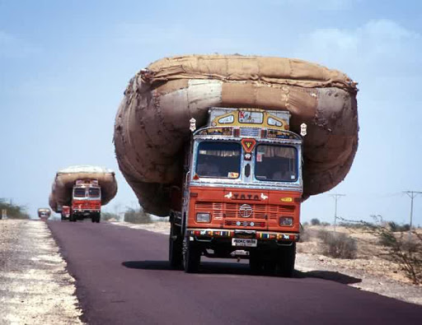
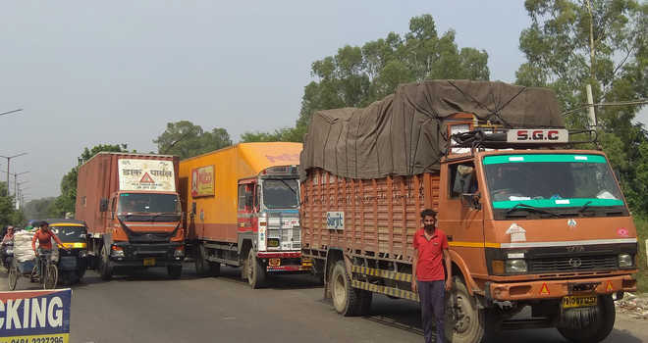
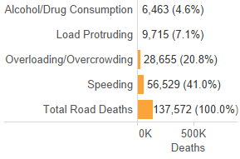
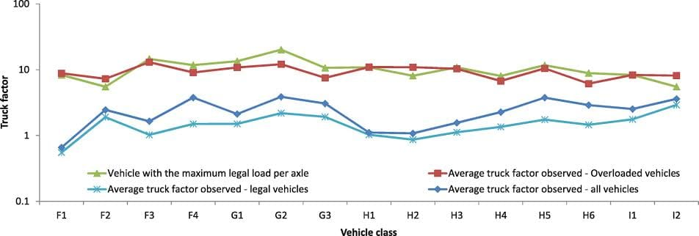
MOTIVATION :
Overloading contribute about 20.8% of the road accidents every year…..
Logistic thefts contribute major loss to the economy
Due to lack of proper communication drivers tend to take traffic routes and tend to cause heavy traffic jam and collision

Slide 4
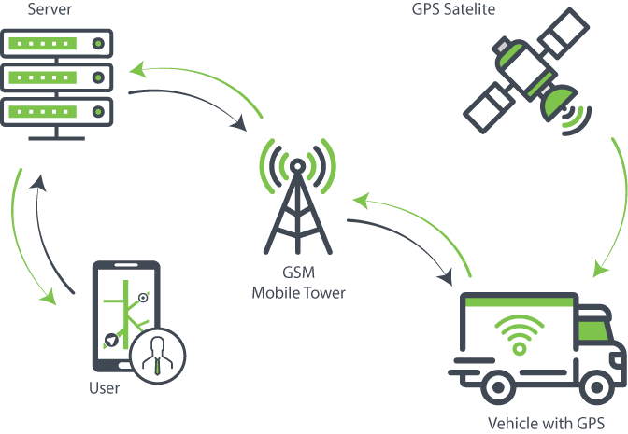
Problem Statement:
An application is required for networking/logistics in an area for all load carrying vehicles. The problem to be addressed are monitoring availability of load vehicles, free routes, toll payment, and etc.

Slide 5
Introduction
As the population of the country and number of vehicles have increased enormously on the nation's roads, new traffic control methods and easy access to roads has become the need of the hour. An app will be developed on this purpose to control the logistics/ networking. The prime goal is to check if the engine, the vehicle and the driver are fit enough for the road. Engine check, brake check and if the driver is non-alcoholic is ensured through the app with the database stored . Three logins are provided namely : Center login, driver login and the public login. Each with its own purpose. GPS tracker showing the feasible route to the driver to the toll that is on the way will be shown to the driver. The owner will be efficiently able to track the driver and his location along with the weight of the load. The public login allows the users to check upon the loaded and the unloaded vehicles on road.

Slide 6
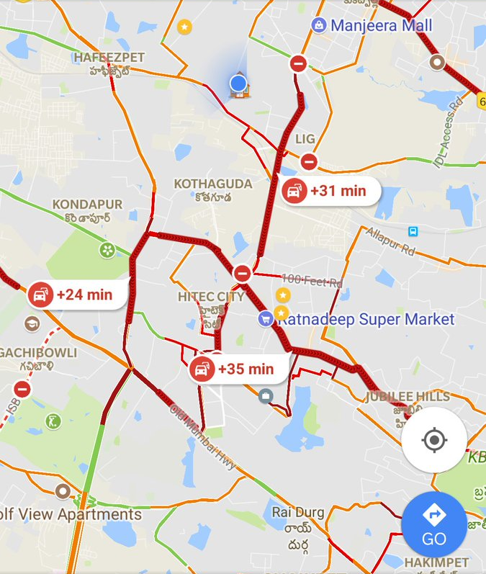


Novelty
User friendly application that allows
Live freight monitoring
Anti- theft
Traffic view with toll gate alert
Rest mode – allow drivers to pit stop
Public Domained Service

Slide 7

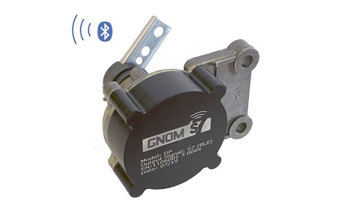




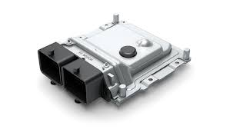
Architecture
Database
GPS
Axle Load Sensor
Micro Controller
Mobile App
ECU

Slide 8
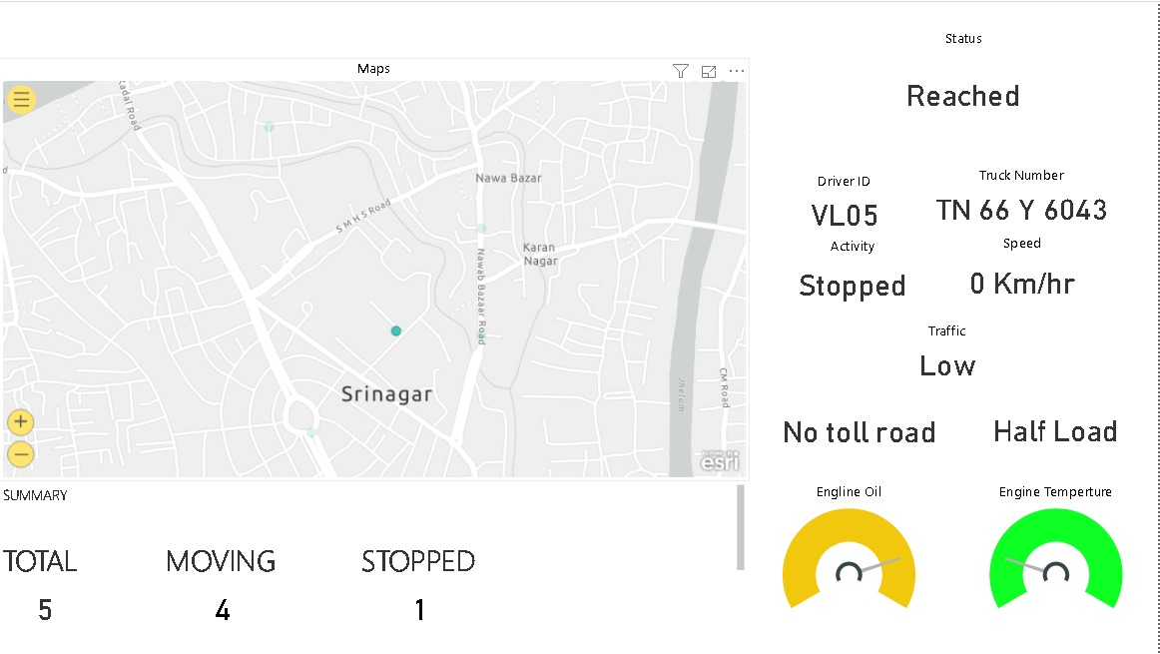
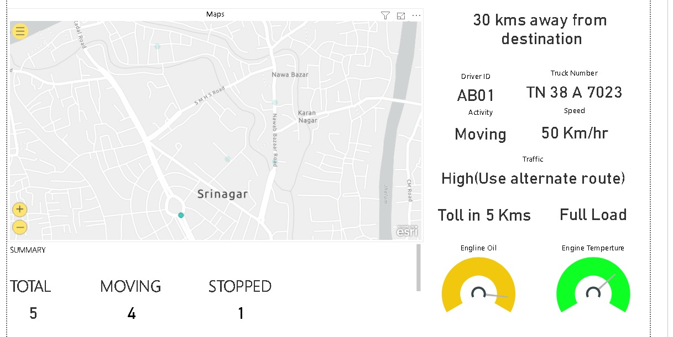
Mobile App

Slide 9
Features
Pros:
Measurements of empty, full-loaded, overloaded of weight.
Loading/unloading events’ ,location on map is updated live
Keep a tight rein on the drivers, who could carry underhand loads
Engine check, and brake system check is thoroughly monitored before starting.
Cons:
Access in Remote areas is difficult

Slide 10
Reference
Leaf spring suspensions-http://skontrol.ru ; https://www.engineersedge.com/
https://www.jv-technoton.com/products/wireless_axle_load_sensor_dde/
Optimization_of_Heavy Vehicle_Suspension_
System : //www.researchgate.net/publication/318793098_
Vehicle-tracking-system -https://www.mobilesalesforceautomation.net
Data Visulisation : https://powerbi.microsoft.com/en-us/

